Slide 1
YOUR FAVOURITE COMIC CHARACTERS

Slide 2
Information about the data
This data was available on DC and Marvel wikias. The data was originally scrapped from the wikias by fivethirtyeight.com which did an analysis on the representation of women in comic books.
What kind of analysis can be done?
How well is the gender represented?
How have the non-hetrosexual characters come to be represented over time?
What facial features are most popular among the characters?

Slide 3
1.
Gender Representation

Slide 4
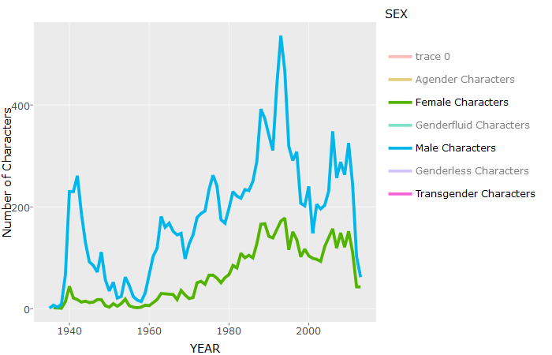

Slide 5
How are the genders represented?
The number of male characters have always outnumbered the female characters.
The number of characters introduced has peaked during 1990s - 2000, indicating the increasing popularity of these comic books – because of the movies .
Non-binary genders are rarely included.

Slide 6
2.
Sexual Inclination

Slide 7
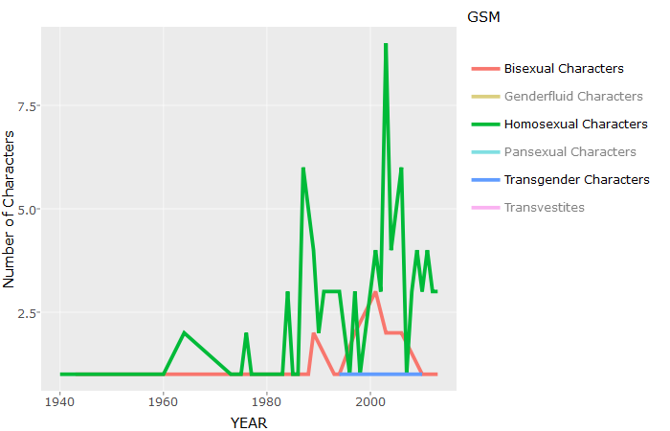

Slide 8
Increasingly inclusive of different sexual inclination
The number of characters with non-heterogeneous sexual inclination has been on the rise.
There is a spike in number of homosexual characters introduced during 1990s and 2000s.

Slide 9
3.
Prominent Characters

Slide 10
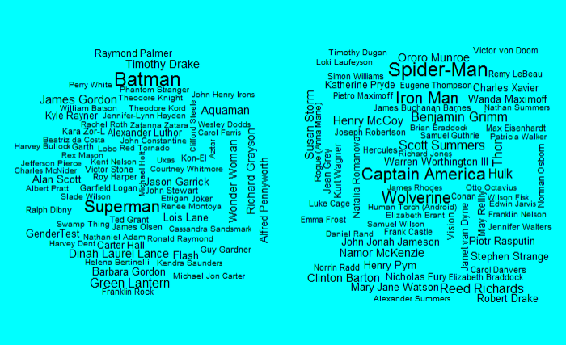

Slide 11
4.
What makes a character Bad?

Slide 12
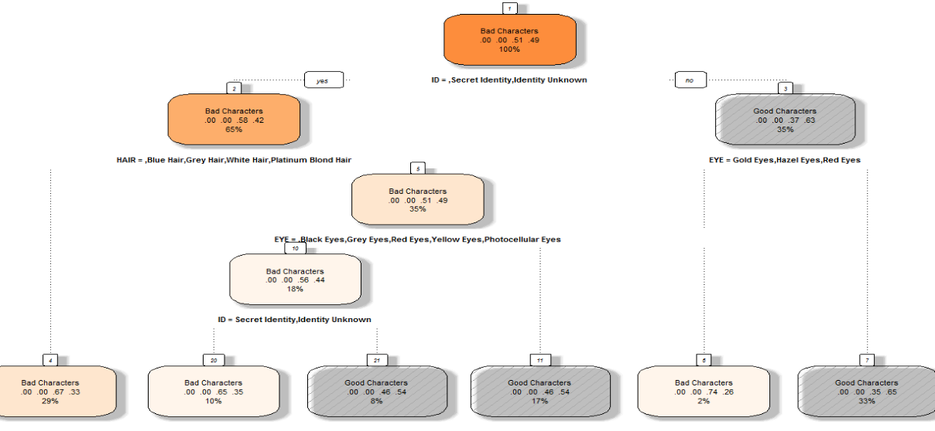
DC Characters

Slide 13
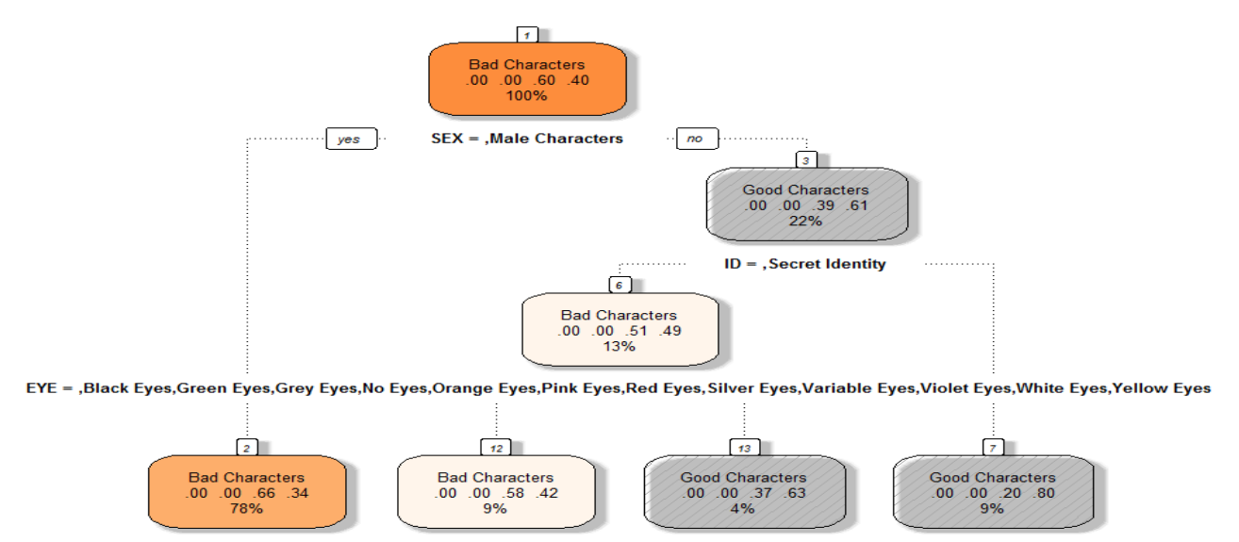
Marvel Characters

Slide 14
Conclusions
With Marvel – if the character is a male there is a high chance of it being a bad character.
Villains generally have their Eye or Hair colour which is very rare if not impossible to find in nature.

Slide 15
Takeaway
Mostly male. Remaining the same.
Increasingly more representative of different sexual preferences..
Marvel – a bit more sexist
Bad characters are mostly stereotyped
Further analysis on the body image of characters can be done.

Slide 16

THANKS!
Any questions?

